Slide 1
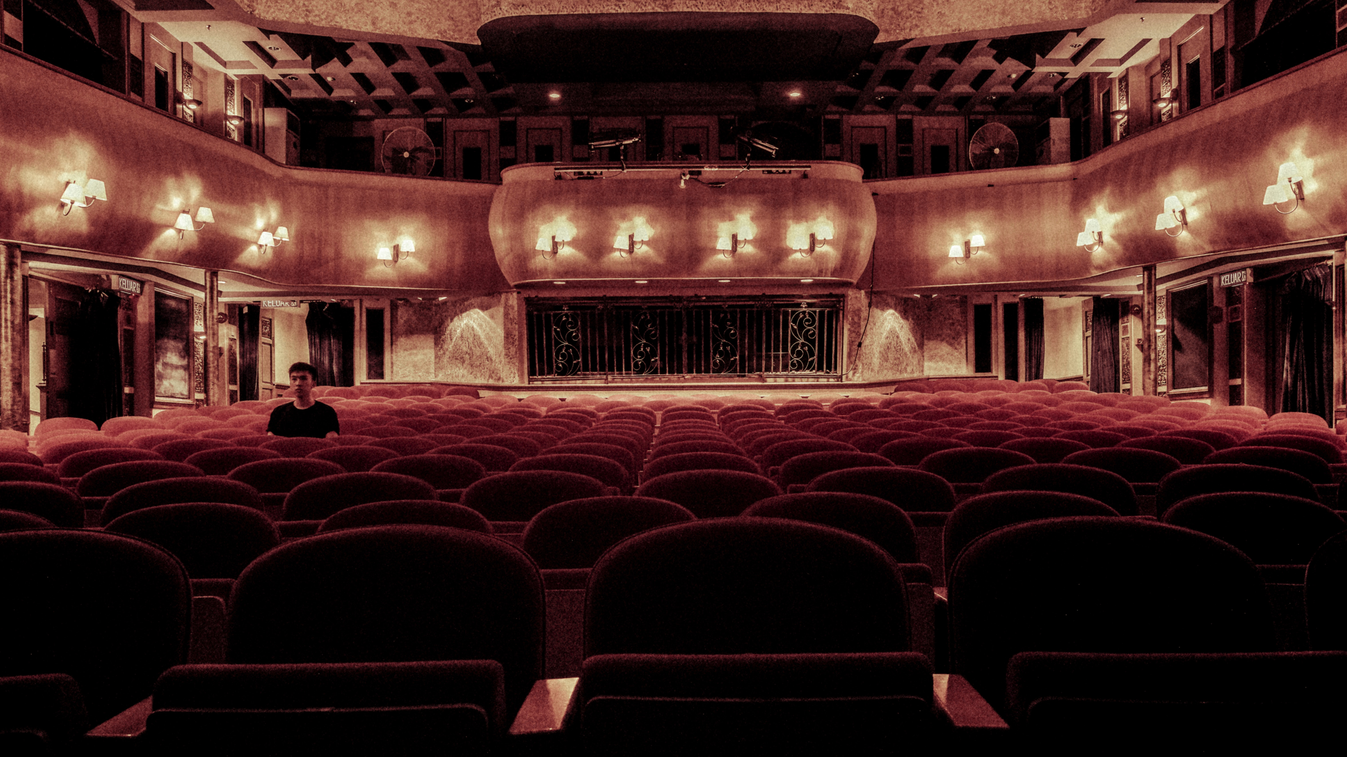

FRENCH PEOPLE HABITS & CINEMA
17th Feb. 2022

Slide 2
AGENDA 1. SCOPE ANALYSIS ……………………… 2. Key figures ……………………… 3. DEEP-DIVE ANALYSIS Visits : - in volume - in time - related to content - related to reviews ………………………

Slide 3

SCOPE ANALYSIS
Our study is done over 2010-2019 time period.
2020 is deliberately excluded since it does not represent a ”normal” year due to covid crisis.
Figures represent French box office.
Figures come from CNC.

Slide 4
KEY FIGURES
2.07b visits over last decade
213m visits in 2019
89% of visits are for full-length future films
49% of visits are for US movies

Slide 5

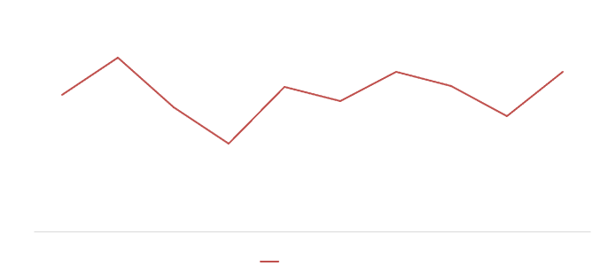
VOLUME of visits’ EVOLUTION People grant same level of interest in cinema year after year
2011
Intouchables success (20M)
2013
None movie beyond 5M visits
2019
Le Roi Lion (10M) & Avengers success (6.9M)

Slide 6
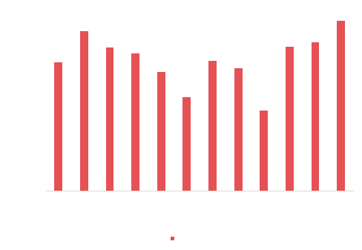
FEBRUARY & DECEMBER
best months to go to the movies
With no suprise school holidays & weather have a direct impact on visits

Slide 7
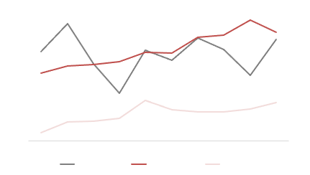
Visits in millions per film category
COURT MÉTRAGE
tend to attract new prospects

Slide 8



US MOVIES KEEP THE 1st POSITION & INCREASE THEIR SHARE OF MARKET
SHARE OF VISITS
2010
2019
42%
57%
39%
61%

Slide 9
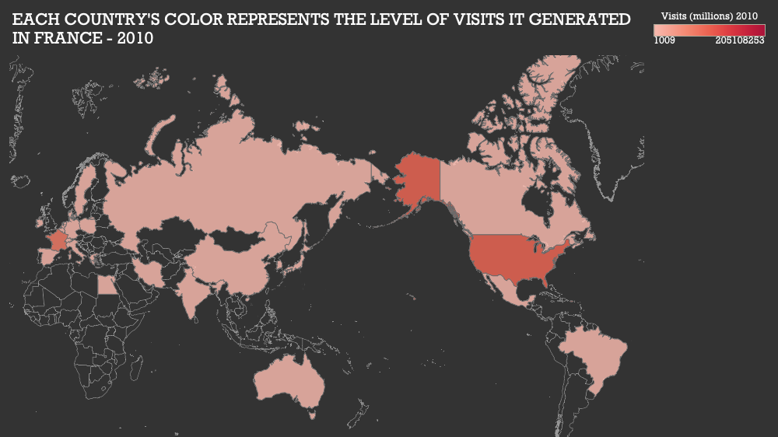

Slide 10
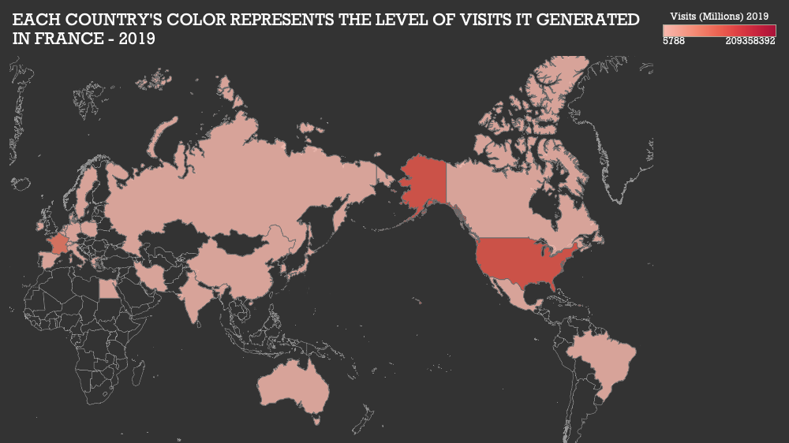

Slide 11
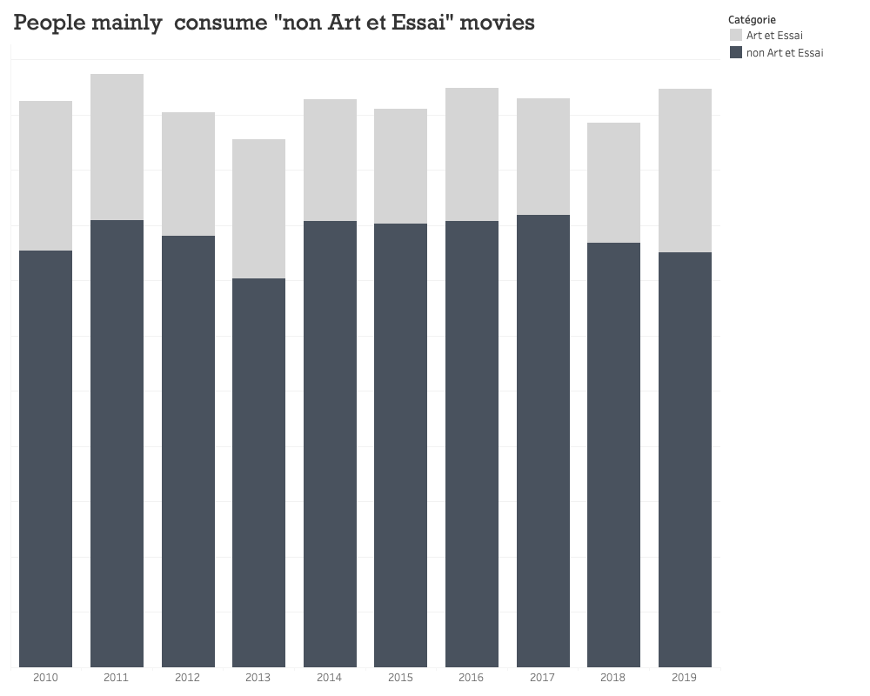

Slide 12
THANK YOU !

